Slide 1


Programming Fundamentals
Aamina Batool

Slide 2
Character Array
Character array: An array whose components are of type char

Slide 3
Null Character
in C++, the null character is represented as '\0’,
The statement:
char ch = '\0';
stores the null character in ch, where ch is a
char variable
the null character is less than any other character in the char data set.

Slide 4
C-string
C-string is inherited from C language
String is born in C++
a string is a sequence of zero or more characters, and strings are enclosed in double quotation marks.
In C++, C-strings are null terminated; that is, the last character in a C-string is always the null character.
The most commonly used term for character arrays is C- strings
C-strings are stored in (one-dimensional) character arrays

Slide 5
Difference b/w‘A’ & “A”
The first one is character A; the second is C-string A.
Because C-strings are null terminated, "A"
represents two characters: 'A' and '\0’.

Slide 6
How to store the string “A” in a
character array?
To store 'A’, we need only one memory cell of type char;
To store "A", we need two memory cells of type
char—one for 'A' and one for '\0'

Slide 7
“Hello”
the C-string
"Hello" represents six characters: 'H', 'e', 'l', 'l', 'o', and '\0’
to store the C-string "Hello“ in computer memory, we need six memory cells of type char.

Slide 8
More Examples
char name[16];
This statement declares an array name of 16 components of type char. Because C-strings are null terminated and name has 16 components,
the largest string that can be stored in name length 15, to leave room for the terminating '\0’.
is of

Slide 9
More Examples
char name[16] = {'J', 'o', 'h', 'n', '\0’};
declares an array name containing 16 components of type
char and stores the C-string "John" in it.
char name[16] = "John";
The statement:
char name[] = "John";
declares a C-string variable name of a length large enough—in this case, 5—and stores "John" in it.

Slide 10
Illegal operations
 char studentName[26];
 studentName = "Lisa L. Johnson"; //illegal

Slide 11
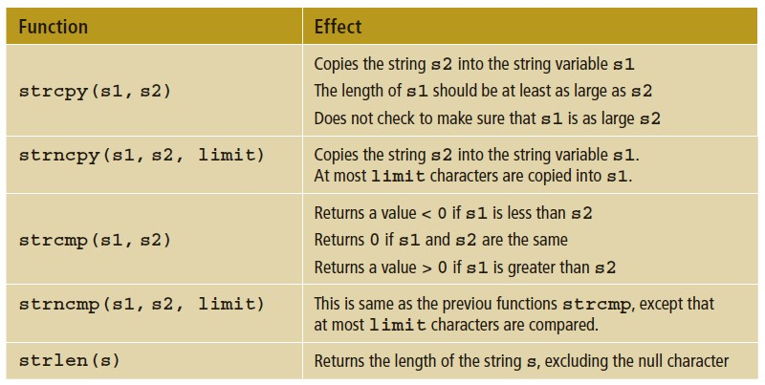
Built-in functions of C-String

Slide 12
String Comparison
 In C++, C-strings are compared character by character using
the system’s collating sequence.
 The C-string "Air" is less than the C-string "Boat" because the first character of "Air" is less than the first character of "Boat".
 The C-string "Air" is less than the C-string "An" because the first characters of both strings are the same, but the second character 'i’ of "Air" is less than the second character 'n' of "An".

Slide 13
String Comparison
 The C-string "Bill" is less than the C-string "Billy" because the first four characters of "Bill" and "Billy" are the same, but the fifth character of "Bill", which is '\0' (the null character), is less than the fifth character of "Billy", which is 'y'. (Recall that C-strings in C11 are null terminated.)
 The C-string "Hello" is less than "hello" because the first character 'H' of the C-string "Hello" is less than the first character 'h' of the C-string "hello".
 the function strcmp compares its first C-string argument with its second
C-string argument character by character.

Slide 14
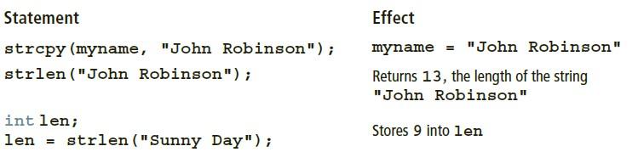
Use of built-in functions
 char studentName[21];
 char myname[16];
 char yourname[16];
 The following statements show how string functions work:

Slide 15
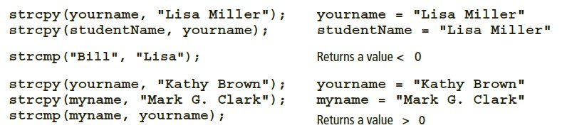
Use of built-in functions

Slide 16

Reading/Writing Strings
 most rules that apply to arrays apply to C-strings as well.
 Aggregate operations, such as assignment and comparison, are not allowed on arrays.
 We know that the input/output of arrays is done component-wise.
 The one place where C++ allows aggregate operations on arrays is the input and output of C-strings (that is, character arrays)

Slide 17
String Input
 char name[31];
 cin >> name;
 stores the next input C-string into name
 The length of the input C-string must be less than or equal to 30.
 If the length of the input string is 4, the computer stores the four
characters that are input and the null character '\0’.

If the length of the input C-string is more than 30, then because there is no check on the array index bounds, the computer continues storing the string in whatever memory cells follow name.
 This process can cause serious problems, because data in the adjacent
memory cells will be corrupted

Slide 18
get Function
 the extraction operator, >>, skips all leading whitespace characters and stops reading data into the current variable as soon as it finds the first whitespace character or invalid data
 C-strings that contain blanks cannot be read using the extraction operator, >>. For example, if a first name and last name are separated by blanks, they cannot be read into name.
 char str[31];
 cin.get(str, 31);
 If the input is:
 William T. Johnson
 then "William T. Johnson" is stored in str. Suppose that the input is:
 Hello there. My name is Mickey Blair.
 which is a string of length 37. Because str can store, at most, 30 characters, the
 C-string "Hello there. My name is Mickey" is stored in str.

Slide 19
String input cont’d
 char str1[26];
 char str2[26];
 char discard;
 two lines of input:
 Summer is warm.
 Winter will be cold.
 suppose that we want to store the first C-string in str1 and the second C-string in str2. Both str1 and str2 can store C-strings that are up to 25 characters in length. Because the number of characters in the first line is 15, the reading stops at '\n’.

Slide 20
String input cont’d
 Now the newline character remains in the input buffer and must be manually discarded.
 Therefore, you must read and discard the newline character at the end of the first line to store the second line into str2.
 The following sequence of statements stores the first line into str1
second line into str2:
 cin.get(str1, 26);
 cin.get(discard);
 cin.get(str2, 26);
 Study this for more information:
https://www.geeksforgeeks.org/clearing-the-input-buffer-in-cc/
and the

Slide 21
getline function
 To read and store a line of input, including whitespace characters, you can also use the stream function getline. Suppose that you have the following declaration:
 char textLine[100];
 cin.getline(textLine, 100);
 The above statement will read and store the next 99 characters, or until the newline character, into textLine. The null character will be automatically appended as the last character of textLine.

Slide 22
String Output
 cout << name;
 outputs the contents of name on the screen.
 The insertion operator, <<, continues to write the contents of name until it finds the null character. Thus, if the length of name is 4, the above statement outputs only four characters. If name does not contain the null character, then you will see strange output because the insertion operator continues to output data from memory adjacent to name until a '\0' is found.

Slide 23
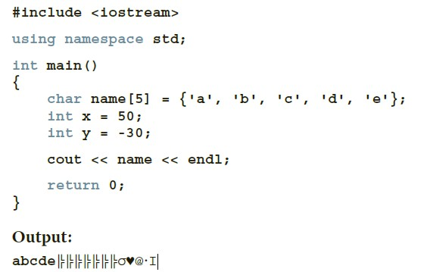
Try this code on your computer

Slide 24
Function
The strlen
 #include <cstring>
 For instance, the following code segment uses the strlen function to determine the length of the string stored in the name array:
 char name[] = "Thomas Edison";
 int length;
 length = strlen(name);

Slide 25
The strcat Function
 The function concatenates or appends one string to another.
 const int SIZE = 13;
 char string1[SIZE] = "Hello ";
 char string2[] = "World!";
 cout << string1 << endl;
 cout << string2 << endl;
 strcat(string1, string2);
 cout << string1 << endl;
 These statements will cause the following output:
 Hello
 World!
 Hello World!

Slide 26
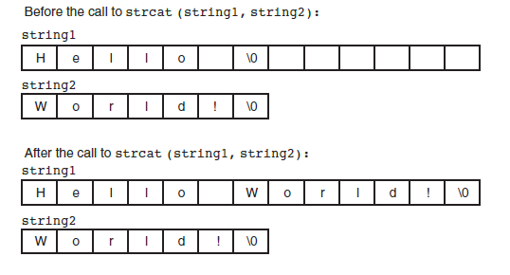
Function
The strcat

Slide 27
The strncat and strncpy Functions (to avoid the out of bound index)
 the the strcat and strcpy functions can potentially overwrite the bounds of an array, they make it possible to write unsafe code.
 As an alternative, you should use strncat and strncpy
whenever possible.
 strncat(string1, string2, 10);
 When this statement executes, strncat will append no more than 10 characters from
 string2 to string1 .

Slide 28
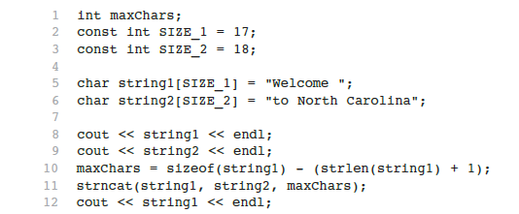
Using strncat function
The statement in line 10 calculates the number of empty elements in string1 . It does this by subtracting the length of the string stored in the array plus 1 for the null terminator. This code will cause the following output:
Welcome
to North Carolina Welcome to North

Slide 29
Using strncpy
 strncpy(string1, string2, 5);
 When this statement executes, strncpy
five characters from
 string2 to string1 .
will copy no more than

Slide 30
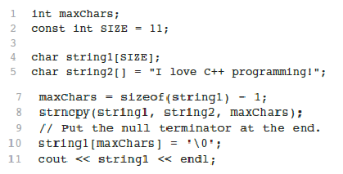
Using strncpy

Slide 31
Exercises
 Find String length, Compare strings,
 Find substring and replace,
 Calculate frequency of specific characters
 Remove specific characters.
 Detecting Palindromes

Slide 32
Reading assignment
 Specifying Input/Output Files at Execution Time (DS Malik page 559)
 string
 string
Type and Input/Output Files (DS Malik page 559)
Type (DS Malik page 492). Explore more about the C++
String type in this section, you can also find a lot of interesting pre-defined functions of string type in this section (but keep in mind the difference of string and c-string).

Slide 33
References
C++ Programming: From Problem Analysis to Program Design, Third Edition
https://www.just.edu.jo/~yahya-t/cs115/

